Slide 1

Hive Assignment – NYC Parking Violations
Student : Jagadish Janakiraman
Submission Date : 8/7/2022

Slide 2
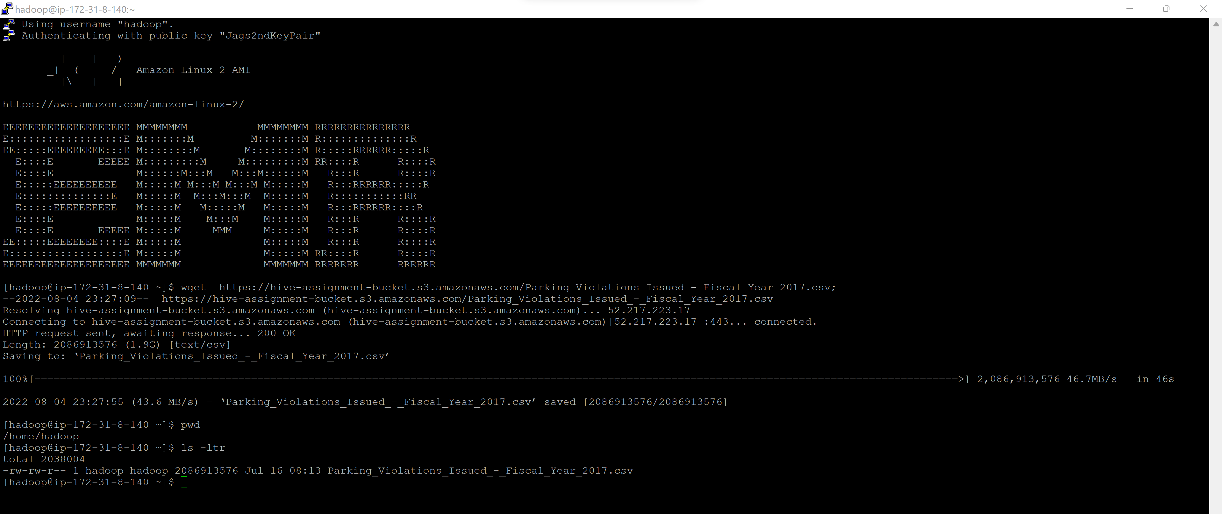
Load Data to EMR
Command –
wget https://hive-assignment-bucket.s3.amazonaws.com/Parking_Violations_Issued_-_Fiscal_Year_2017.csv;
Output Screenshot -

Slide 3
Load Data to Table
Commands –
CREATE TABLE IF NOT EXISTS parkingviolations (SummonsNumber bigint, PlateID String, RegistrationState String,PlateType String, IssueDate String,ViolationCode int, VehicleBodyType String,VehicleMake String, IssuingAgency String,StreetCode1 int , StreetCode2 int ,StreetCode3 int , VehicleExpirationDate int ,ViolationLocation String, ViolationPrecinct int ,IssuerPrecinct int , IssuerCode int ,IssuerCommand String, IssuerSquad String,ViolationTime String, TimeFirstObserved String,ViolationCounty String, ViolationInFrontOfOrOpposite String,HouseNumber String, StreetName String,IntersectingStreet String, DateFirstObserved int ,LawSection int , SubDivision String,ViolationLegalCode String, DaysParkingInEffect String ,FromHoursInEffect String, ToHoursInEffect String,VehicleColor String, UnregisteredVehicle String,VehicleYear int , MeterNumber String,FeetFromCurb int , ViolationPostCode String,ViolationDescription String, NoStandingorStoppingViolation String,HydrantViolation String, DoubleParkingViolation String) COMMENT 'parkingviolations assignment' ROW FORMAT DELIMITED FIELDS TERMINATED BY ',' LINES TERMINATED BY '\n' tblproperties('skip.header.line.count'='1’);
load data local inpath '/home/hadoop/Parking_Violations_Issued_-_Fiscal_Year_2017.csv' into table parkingviolations ;

Slide 4
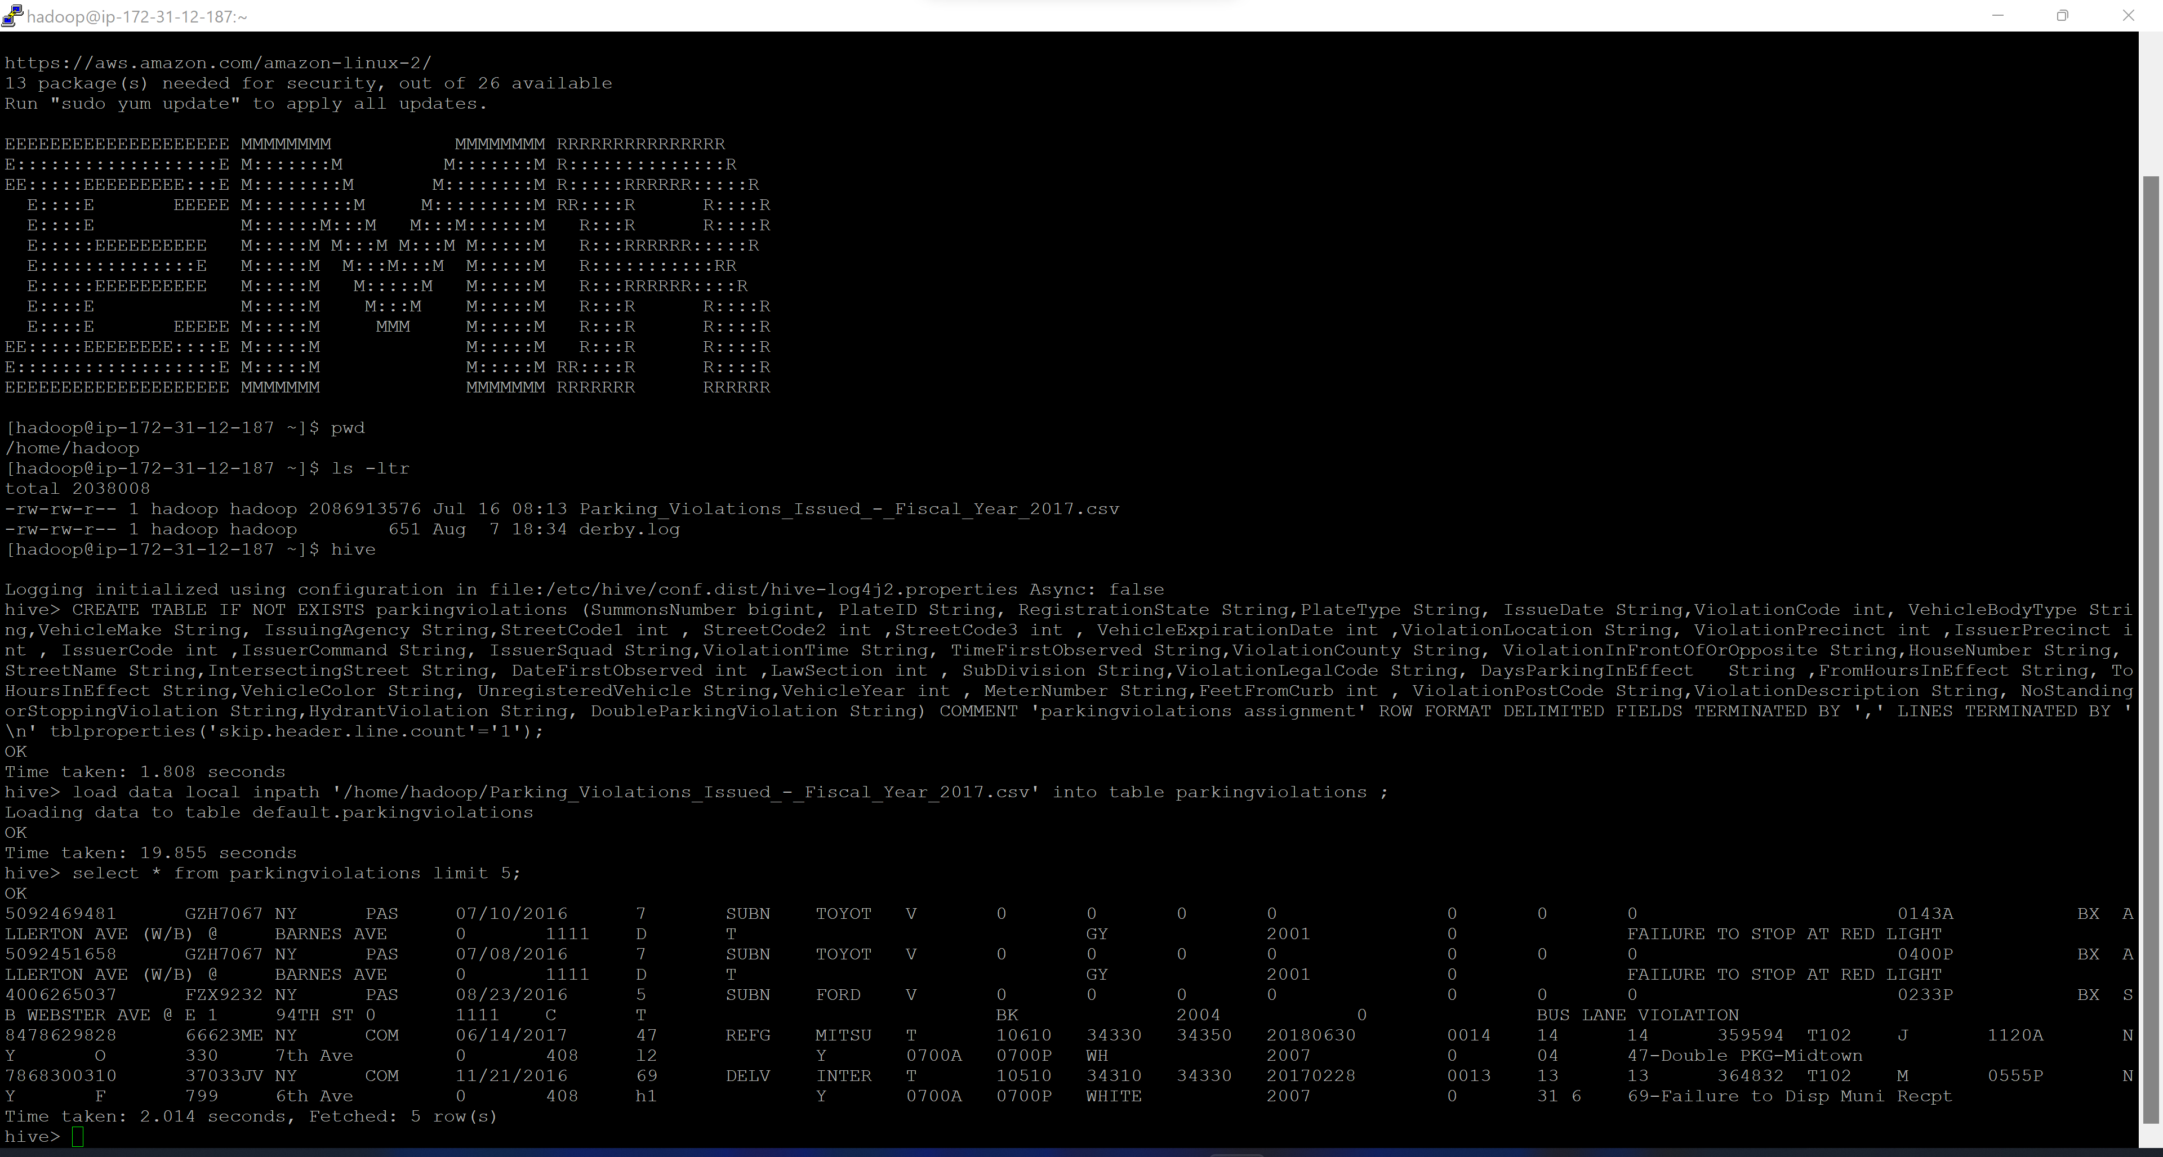
Output Screenshot -

Slide 5
Part-I: Examine the data

Slide 6
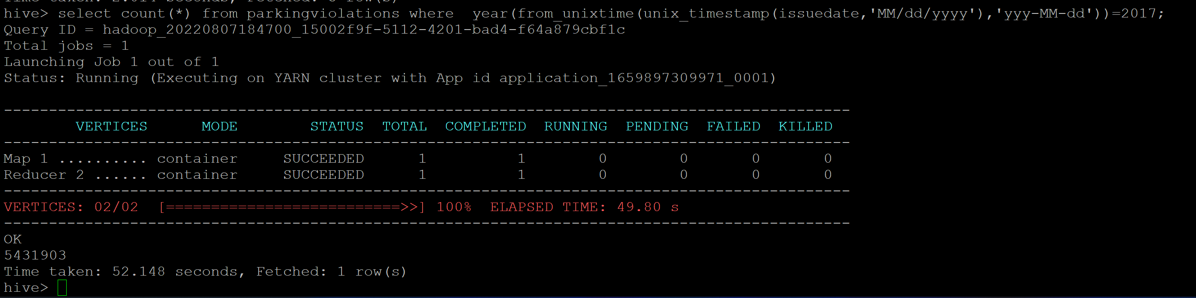
Q1.1 - Find the total number of tickets for the year.
Command –
select count(*) from parkingviolations where year(from_unixtime(unix_timestamp(issuedate,'MM/dd/yyyy'),'yyy-MM-dd'))=2017;
Answer – There are 5,431,903 parking violations in the year 2017
Output Screenshot -

Slide 7
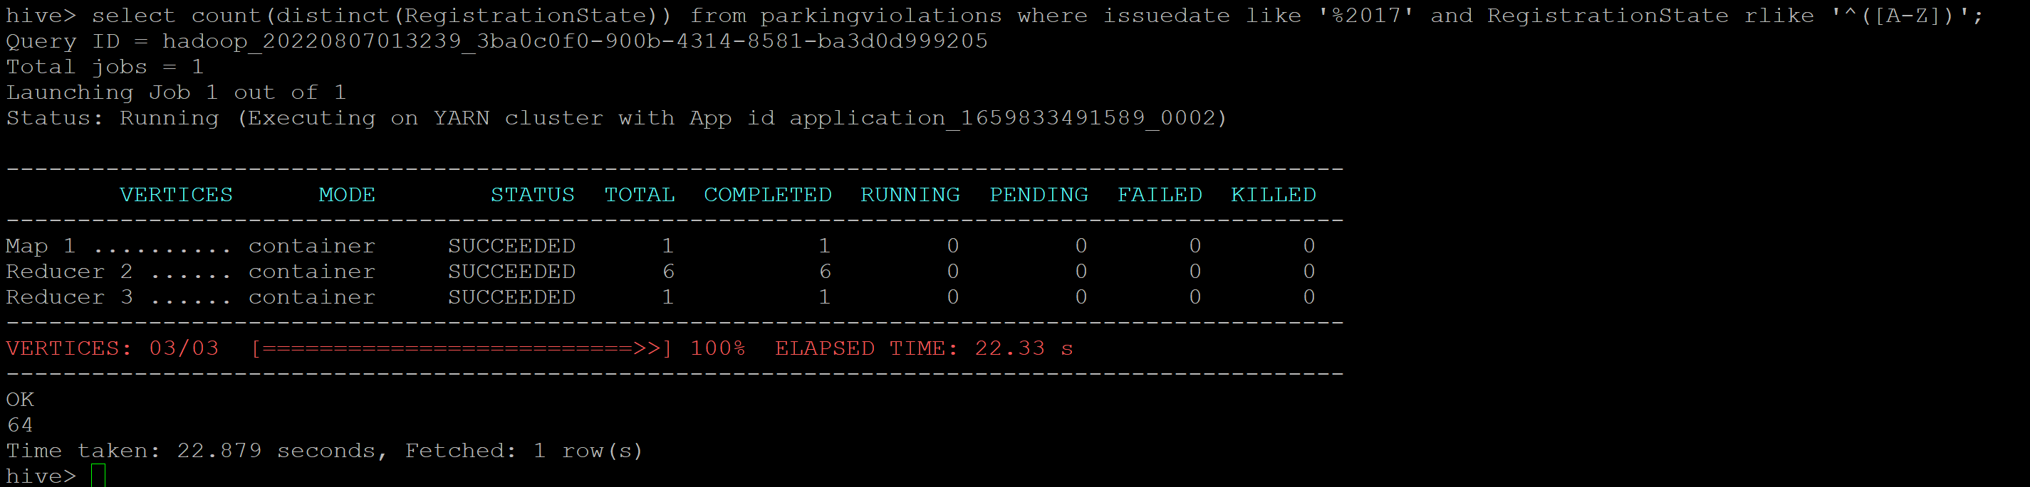
Q1.2 - Find out the total number of states to which the cars with tickets belong.
Command - select count(distinct(RegistrationState)) from parkingviolations where issuedate like '%2017' and RegistrationState rlike '^([A-Z])';
Answer – Cars belong to 64 States with ticket
Output Screenshot -

Slide 8
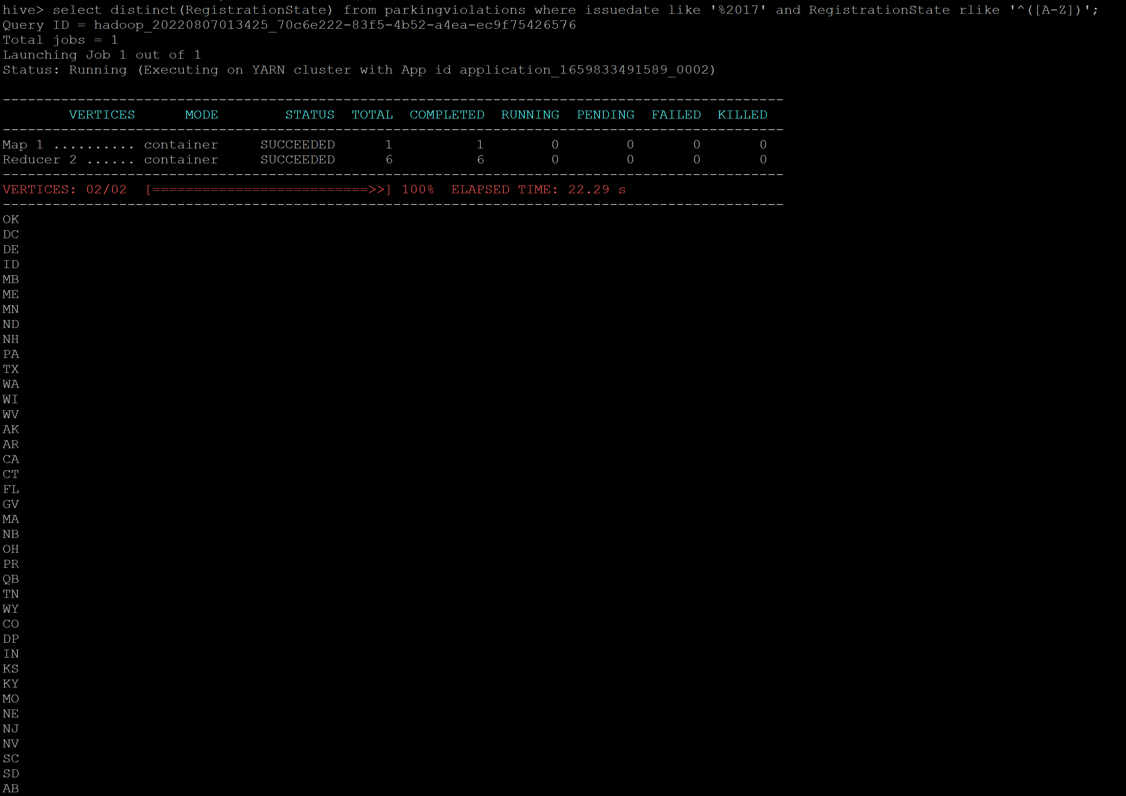
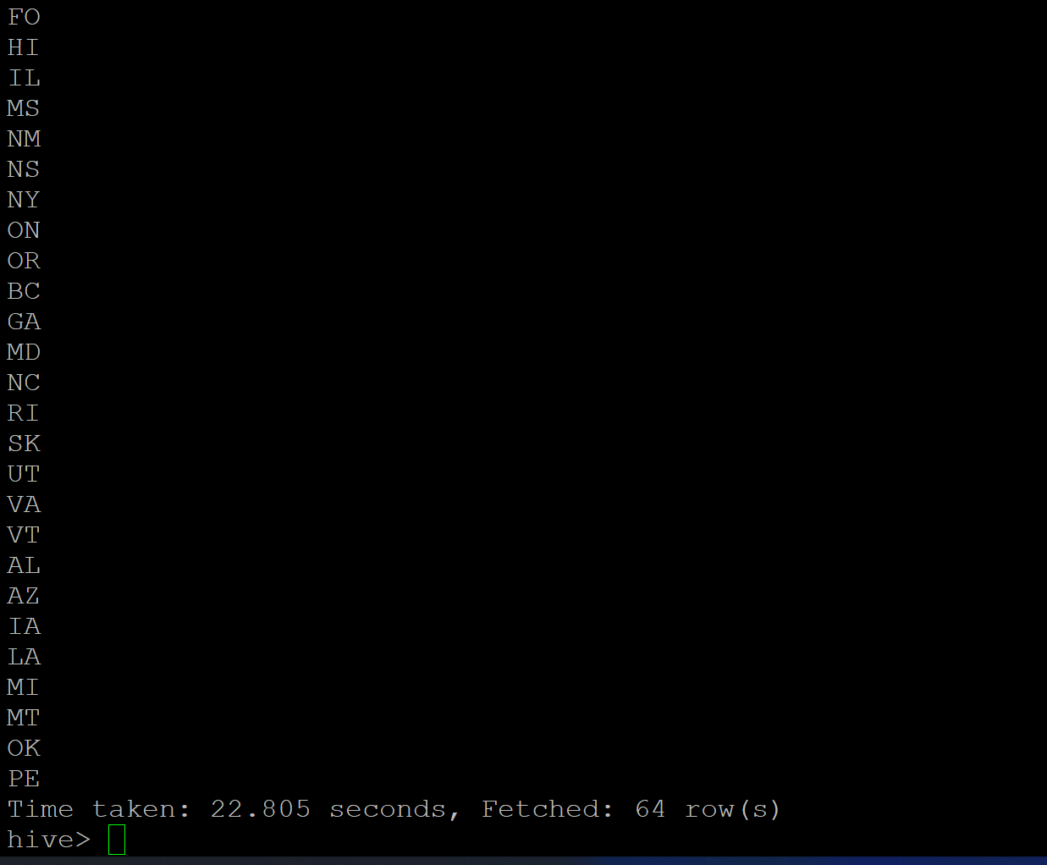
Q1.2 Optional Question – List of states with tickets
Command - select distinct(RegistrationState) from parkingviolations where issuedate like '%2017' and RegistrationState rlike '^([A-Z])’;
Answer – Cars belong to 64 States with ticket
Output Screenshot -

Slide 9
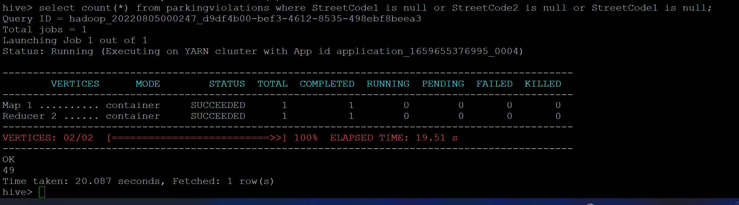
Q1.3 – Find out the number of such tickets which have no addresses.
Command - select count(*) from parkingviolations where StreetCode1 is null or StreetCode2 is null or StreetCode1 is null;
Answer – 49 tickets have no addresses (either of StreetCode1, 2 and 3 is null)
Output Screenshot -

Slide 10
Part-II: Aggregation tasks

Slide 11
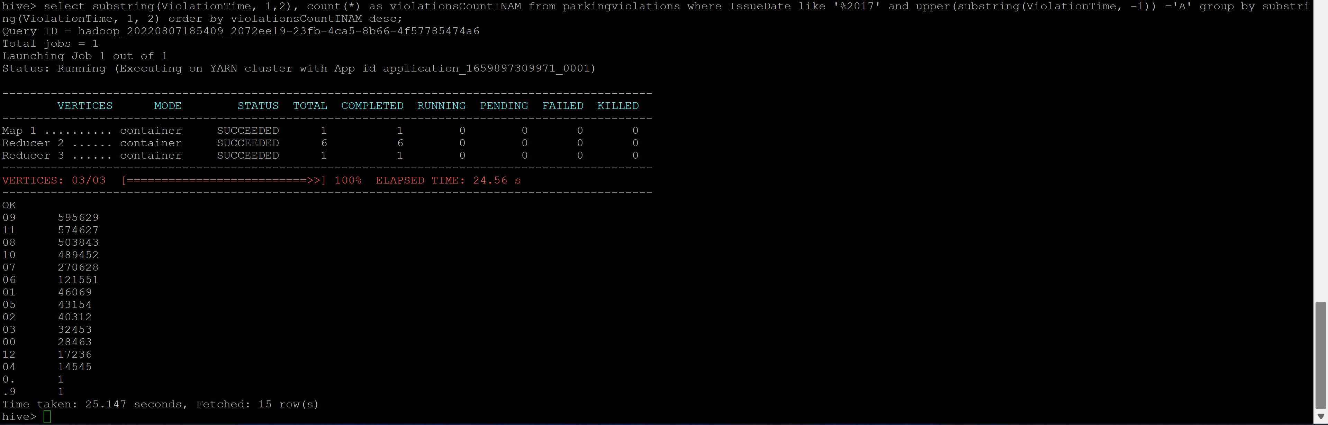
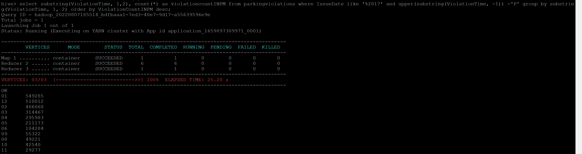
Q2.1 – Find out the frequency of parking violations across different times of the day
Commands –
select substring(ViolationTime, 1,2), count(*) as violationsCountINAM from parkingviolations where IssueDate like '%2017' and upper(substring(ViolationTime, -1)) ='A' group by substring(ViolationTime, 1, 2) order by violationsCountINAM desc;
select substring(ViolationTime, 1,2), count(*) as violationcountINPM from parkingviolations where IssueDate like '%2017' and upper(substring(ViolationTime, -1)) ='P' group by substring(ViolationTime, 1, 2) order by ViolationCountINPM desc;
Answer – 9 AM and 1 PM are the hours with maximum parking violations.
Output Screenshot -
Violations in AM (Morning)
Violations in PM (Evening)

Slide 12
Q2.2 – Divide 24 hours into six equal discrete bins of time. The intervals you choose are at your discretion. For each of these groups, find the 3 most commonly occurring violations.
Command –
select * from (
select violationbin,violationcode,ViolationCount, dense_rank() over (partition by violationbin order by ViolationCount desc) as rank
from
( Select violationbin, ViolationCode, count(*) as ViolationCount from
( select case
when substring(violationtime,1,2) in ('00','12','01','02','03') and upper(substring(violationtime,-1))='A' then 'MidNight_12AM_3AM'
when substring(violationtime,1,2) in ('04','05','06','07') and upper(substring(violationtime,-1))='A' then 'EarlyMorning_4AM_7AM'
when substring(violationtime,1,2) in ('08','09','10','11') and upper(substring(violationtime,-1))='A' then 'Morning_8AM_11AM'
when substring(violationtime,1,2) in ('12','01','02','03') and upper(substring(violationtime,-1))='P' then 'AfterNoon_12PM_3PM'
when substring(violationtime,1,2) in ('04','05','06','07') and upper(substring(violationtime,-1))='P' then 'Evening_4PM_7PM'
when substring(violationtime,1,2) in ('08','09','10','11') and upper(substring(violationtime,-1))='P' then 'Night_8PM_11PM'
else null end as violationbin, ViolationCode from parkingviolations where IssueDate like '%2017'
)temp1
where violationbin is not NULL group by violationbin,ViolationCode
) temp2
) temp3 where rank <= 3 ;

Slide 13
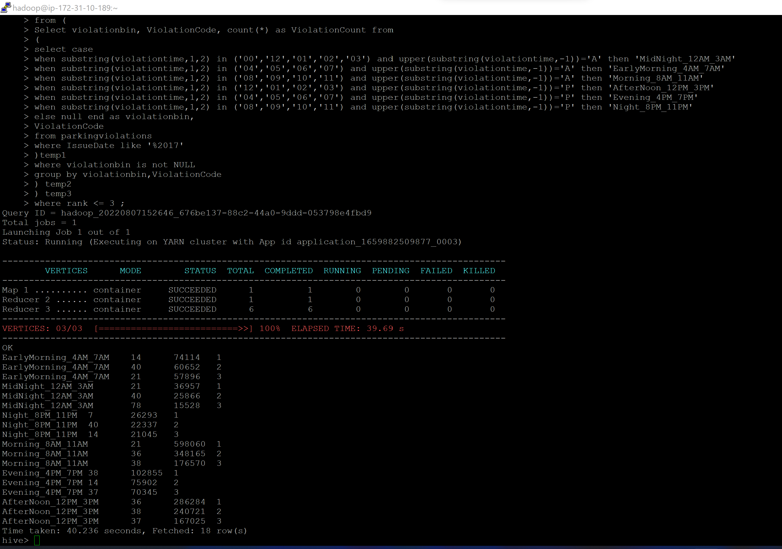
Output Screenshot -

Slide 14
Q2.3 – For the 3 most commonly occurring violation codes, find the most common times of day (in terms of the bins from the previous part).
Command –
select ViolationCode, ViolationTime_bin , count(*) as countByViolation from (
SELECT ViolationCode,
case
when substring(ViolationTime,1,2) in ('00','01','02','03','12') and upper(substring(ViolationTime,-1))='A' then 'MidNight_12AM_3AM'
when substring(ViolationTime,1,2) in ('04','05','06','07') and upper(substring(ViolationTime,-1))='A' then 'EarlyMorning_4AM_7AM'
when substring(ViolationTime,1,2) in ('08','09','10','11') and upper(substring(ViolationTime,-1))='A' then 'Morning_8AM_11AM'
when substring(ViolationTime,1,2) in ('12','00','01','02','03') and upper(substring(ViolationTime,-1))='P' then 'AfterNoon_12PM_3PM'
when substring(ViolationTime,1,2) in ('04','05','06','07') and upper(substring(ViolationTime,-1))='P' then 'Evening_4PM_7PM'
when substring(ViolationTime,1,2) in ('08','09','10','11') and upper(substring(ViolationTime,-1))='P' then 'Night_8PM_11PM'
else null end as ViolationTime_bin from parkingviolations where IssueDate like '%2017'
and (length(ViolationTime)=5 and upper(substring(ViolationTime,-1)) in ('A','P') and substring(ViolationTime,1,2) in ('00','01','02','03','04','05','06','07', '08','09','10','11','12') )) ViolationTable
group by ViolationCode, ViolationTime_bin
order by countByViolation desc
limit 3 ;

Slide 15
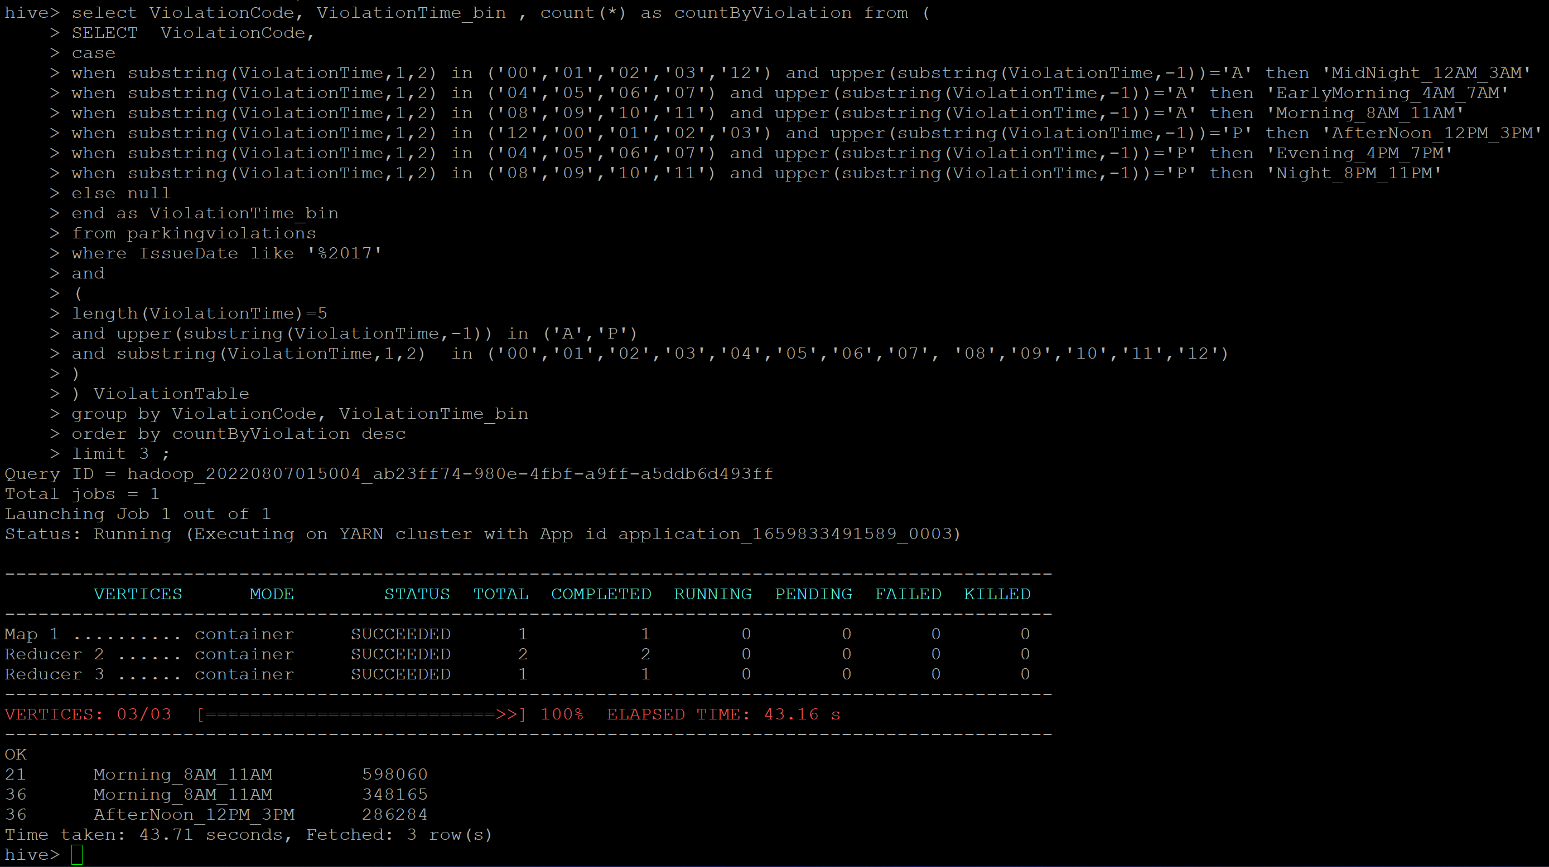
Output Screenshot -

Slide 16
Q2.4.1 – First, divide the year into seasons, and find the frequencies of tickets for each season.
Command –
select seasonbin, count(*) as countByViolation from
(
SELECT ViolationCode,
case when month(from_unixtime(unix_timestamp(issuedate,'MM/dd/yyyy'),'yyy-MM-dd')) in (3,4,5) then 'SPRING'
when month(from_unixtime(unix_timestamp(issuedate,'MM/dd/yyyy'),'yyy-MM-dd')) in (6,7,8) then 'SUMMER'
when month(from_unixtime(unix_timestamp(issuedate,'MM/dd/yyyy'),'yyy-MM-dd')) in(9,10,11) then 'FALL'
when month(from_unixtime(unix_timestamp(issuedate,'MM/dd/yyyy'),'yyy-MM-dd')) in (1,2,12) then 'WINTER'
else 'unknown' end as seasonbin
from parkingviolations
where IssueDate like '%2017'
) ViolationTable
group by seasonbin order by countByViolation desc;

Slide 17
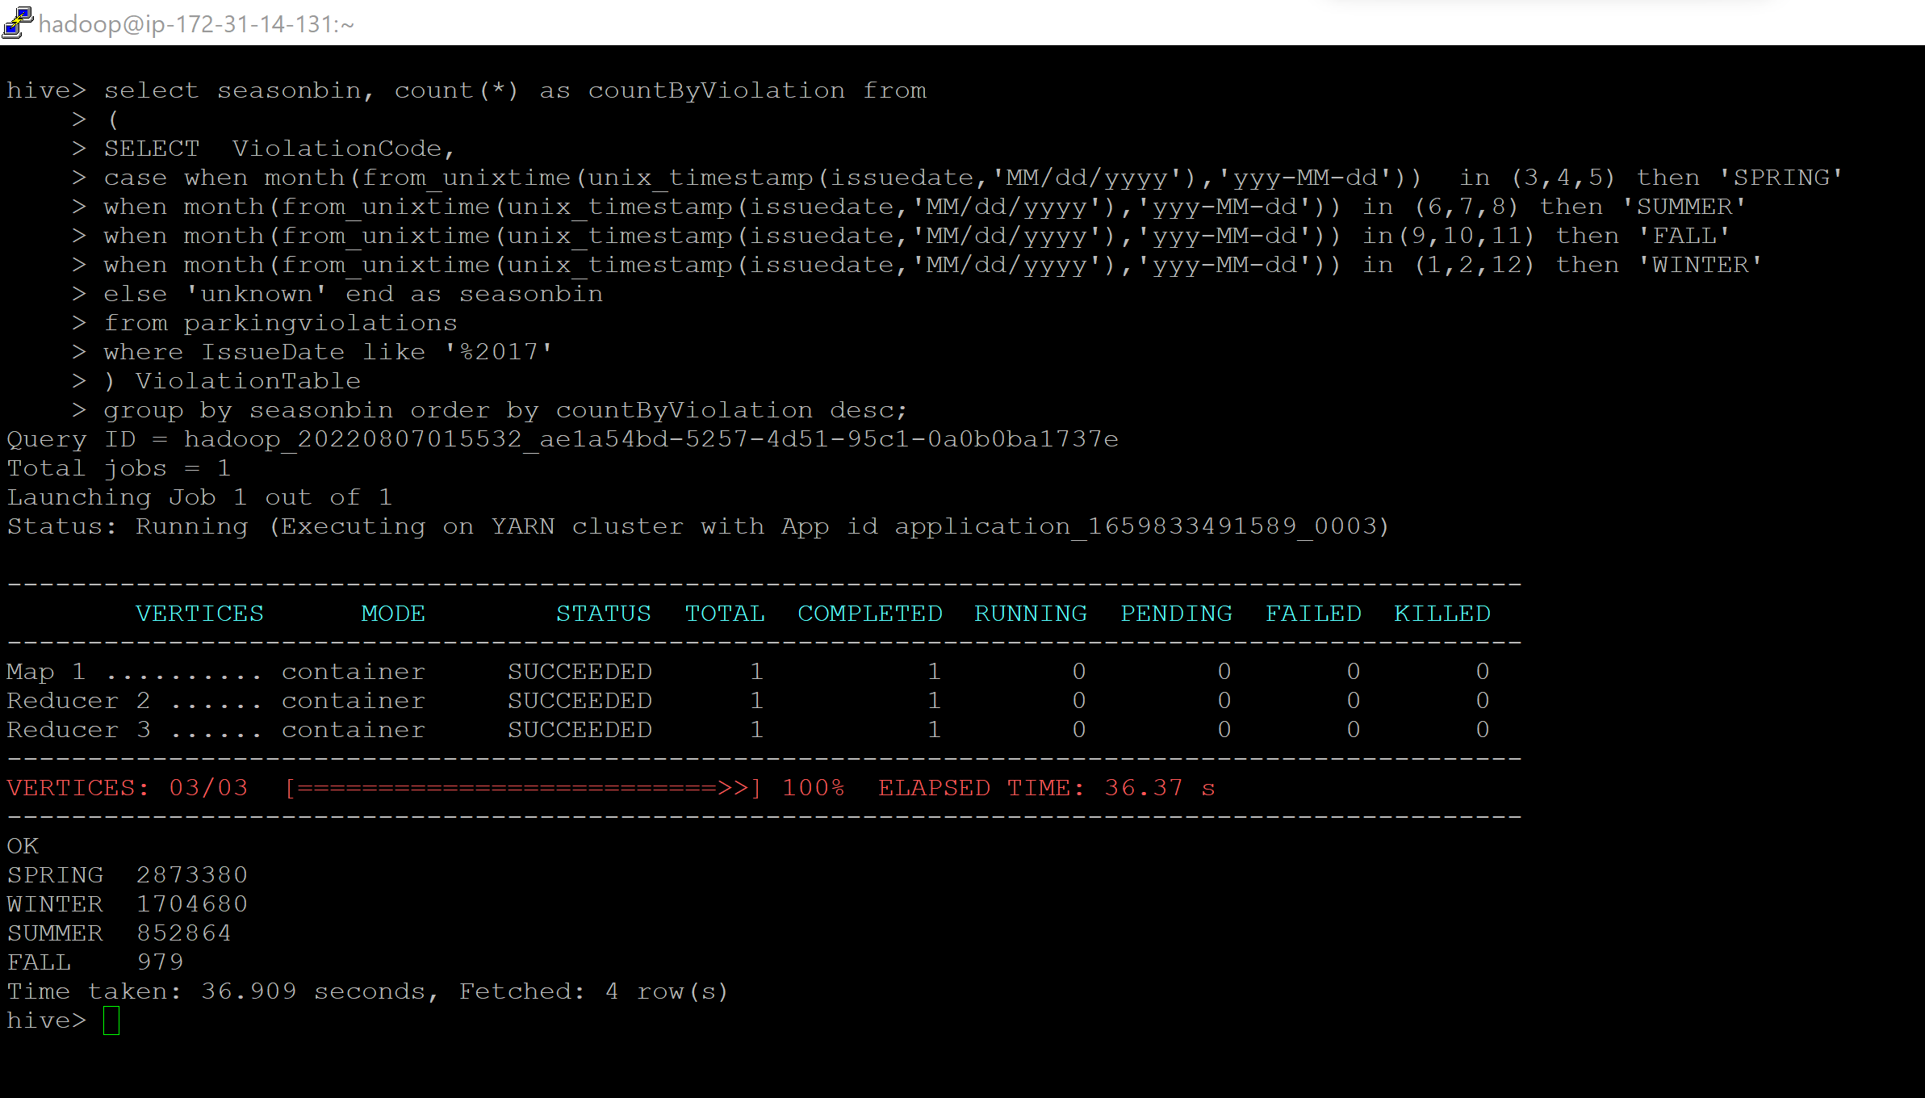
Output Screenshot -

Slide 18
Q2.4.2 – Find the 3 most common violations for each of these seasons
Command –
select * from (
select seasonbin,ViolationCode,ViolationCount, dense_rank() over (partition by seasonbin order by ViolationCount desc) as rank
from (
Select seasonbin, ViolationCode, count(*) as ViolationCount from
(
SELECT
case when month(from_unixtime(unix_timestamp(issuedate,'MM/dd/yyyy'),'yyy-MM-dd')) in (3,4,5) then 'SPRING'
when month(from_unixtime(unix_timestamp(issuedate,'MM/dd/yyyy'),'yyy-MM-dd')) in (6,7,8) then 'SUMMER'
when month(from_unixtime(unix_timestamp(issuedate,'MM/dd/yyyy'),'yyy-MM-dd')) in(9,10,11) then 'FALL'
when month(from_unixtime(unix_timestamp(issuedate,'MM/dd/yyyy'),'yyy-MM-dd')) in (1,2,12) then 'WINTER'
else 'unknown' end as seasonbin ,
ViolationCode
from parkingviolations
where IssueDate like '%2017'
) temp1
group by seasonbin,ViolationCode
) temp2
)temp3
where rank <= 3 ;

Slide 19
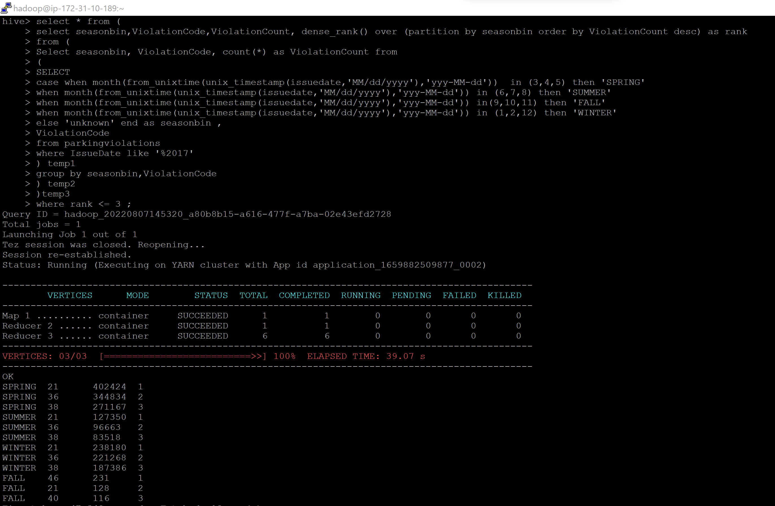
Output Screenshot -

Slide 20
Thank You

